Slide 1
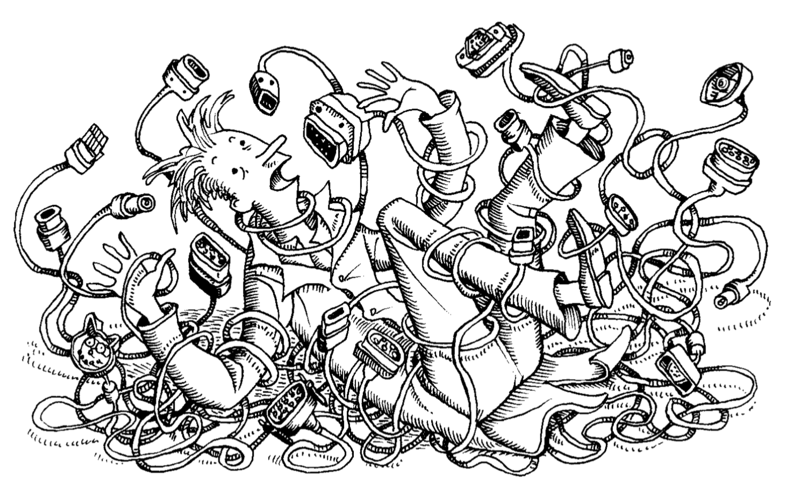
Intro to Networks

Slide 2
Networking for System Administration
We will be discussing networks primarily through TCP/IP (with a bit of UDP)
Focus will primarily be on how to create and administer local networks, which will include how these networks connect to the internet but not how the internet functions (which is different from local networks)
The network services we discuss will be in the context of local networking
We will be discussing core networking concepts (routing, packet addressing, etc.) at a relatively high level
Typically this discussion will provide just enough information to perform a system administration task such as network design or traffic debugging

Slide 3
The Open System Interconnect (OSI) Model
Ratified in ~1983 by the International Organization for Standardization (ISO)
Made up of 7 different levels of independent network abstraction
Acrostic for remembering the levels: “All People Sip Tea Not Dr. Pepper”
Physical
Data Link
Network
Transport
Session
Presentation
Application

Slide 4
Level 1 (L1) - Physical
Physical connection between network devices (computers & networking appliances)
Fiber, Ethernet, Wireless, etc.
Data is carried and represented in its binary form (whatever that means for the physical connection carrying it)
Handles flow control (when it should be sending vs. receiving) and limited error correction (usually through redundancy)
Translates data layer requests into hardware-specific operations and passes incoming bitstreams to the data layer for processing

Slide 5
Level 2 (L2) - Data
Frame
Packet
Segment
Data
Frame
Uses a data frame to encode the source and destination MAC addresses as well as a error checksum around an IP packet
Frame adds two 6 byte MAC addresses (plus 2 for additional data)
Frame also adds a 4 byte checksum for error correction
MAC Addresses are how individual machines are “uniquely” addressed
MAC Addresses are set per-device by the manufacturer
Handles sending information from one device on the local network to another
Individual data frames cannot cross networks, although their internal data can
The data layer is actually made up of two layers (more on this later)
Notes:
MAC addresses on machines can typically be changed from the default manufacturers version, so they are typically unique but could be made non-unique (don’t do this)
When a data frame needs to cross from one network to another the router takes the data frame, de-encapsulates it to inspect the IP packet it holds, then creates a new data frame with a new source and destination address which is valid on the new network. So while that particular data frame can't cross the network barrier the data it holds can be being re-encapsulated in a new data frame.

Slide 6
Level 3 (L3) - Network
Packet
Segment
Data
The layer containing the internet protocol (IP) which works with packets
Packet adds two 4 byte IP addresses (plus 16 bytes of additional information including time to live and total length)
Handles moving data between networks, a process known as routing
When data gets to a network boundary, the frame is removed and the IP addresses are inspected to know what new frame to create
Performs no error control or correction itself

Slide 7
Level 4 (L4) - Transport
Segment
Data
Service to Service or Host to Host communication using either the Transmission Control Protocol (TCP) or User Datagram Protocol (UDP) and addressed through port numbers
TCP: send it and expect a response with an unordered delivery
UDP: send it and forget it protocol with an ordered delivery (best effort)
The Internet Assigned Numbers Authority (IANA) keeps a list of well known ports (0 - 1023) which are the ones requiring elevated permissions in order to bind to in Linux/UNIX
Handles flow control, congestions, errors, and multiplexing

Slide 8
Level 5 (L5) - Session
Level 6 (L6) - Presentation
Data
Handles opening, closing, and managing a connection session between end-user applications over a network
Sockets implement this layer when using UNIX*
Covers data conversion, character code translation, compression, encryption and decryption between the network format and what is expected by your application
Notes:
There is some debate about where in the OSI layer sockets actually exist since its a networking abstraction and sockets aren’t really part of networking but wikipedia says it belongs to OSI layer 5 and I agree.

Slide 9
Level 7 (L7) - Application
Data
All applications that utilize the network fall under this layer
Remote Host Login: Telnet, Secure Shell (SSH)
File Transfer: File Transfer Protocol (FTP), Trivial File Transfer Protocol (TFTP)
Electronic Mail: Simple Mail Transfer Protocol (SMTP)
Networking Support: Domain Name System (DNS)
Remote host management: Simple Network Management Protocol (SNMP), Common Management Information Protocol over TCP (CMOT)

Slide 10
OSI Data Transfers
User Data
Application
Application Header
User Data
Segment Header
Application Data
Transport
TCP Segment
IP Header
Segment Header
Application Data
Network
IP Packet
Frame Header
IP Header
Segment Header
Application Data
Frame Header
Data Link
Ethernet Frame
46 to 1500 bytes
Physical Medium

Slide 11
How Data Moves
User Data
User Data
Application Data
Application Data
Application Data
Segment Header
Segment Header
Application Data
TCP Segment
TCP Segment
Application Data
Segment Header
IP Header
IP Header
Segment Header
Application Data
IP Packet
IP Packet
Frame Header
Application Data
Segment Header
IP Header
Frame Header
Frame Header
IP Header
Segment Header
Application Data
Frame Header
Physical Connection
Notes:
Data is taken by an application and encoded into a TCP or UDP segment. From there it is given an IP header with source and destination IP address for its network interface and then encoded into a frame with its source MAC address and its destination MAC address. From there the binary version of that frame is put onto a physical connection and the network interface sends the frame to the destination MAC address. When it gets there the network interface which represents the destination MAC address, that network interface de-encapsulates the frame to get the packet which is then has its IP inspected to know if the message was meant for me or not (it could not be for you, although that doesn’t really happen). The IP header then has its header cut off and the segment header is inspected to know which port to send the application data to, which is then cut off and sent to the correct port.

Slide 12
Alternative View (DoD)
More condensed view of the networking abstraction model with only 4 layers
Better segmented to the layer we actually need to differentiate between
We will typically refer to this model, but you should know the OSI model
Application
Presentation
Session
Process/Application
Transport
Host to Host (Transport)
Network
Internet (IP)
Data Link Layer
Network Access
Physical

Slide 13
Questions?

Slide 14
Additional Resources
IANA Service Name and Transport Protocol Port Number Registry

